Slide 1
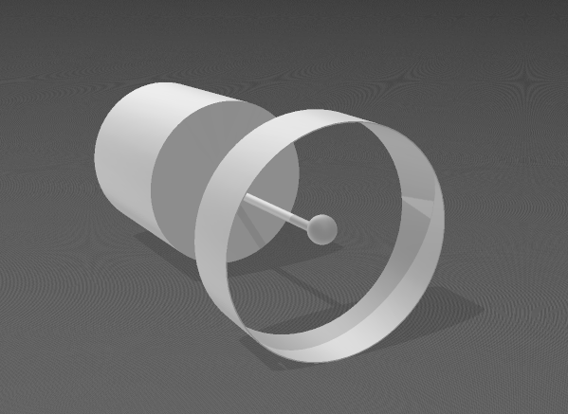
In one of the Gravity and Antimatter dynamics methods for interstellar propulsion from the World Peace Alliance and in a mathematical theory approach when a specific trapped mass is hit by powerful argon laser to heat it up to 4 Million kelvin, the cylinder magnetic field is increased to stimulate the superconducting molecular metal/crystal band around the super heated mass (Magnetic field-induced superconductivity), there is a big question about the formation of antimatter and flux quantization driven by magnetic pressures?, then the mass temperature could be increased to 24Million Kelvin (10x less than a quark gluon plasma) providing a 98% gamma ray thrust + 2% cosmic ray energy distribution that can achieve 3.5KM and thus a high energy photon propulsion.
https://www.worldpeacetoall.org/deep-future-markets.html

